Slide 1

Gender Identity and Sexuality Spectrum
By: Ali, Audrey, Matthew, Nichelle, and Reilly
Notes:
Let me know what you think…

Slide 2
Introduction
Human Sexuality and Gender Identity are extremely complex, It is impossible to label everyone. Human Sexuality and Gender Identity are on a spectrum. For this assignment we will try our best to explain components of an infinitely complex subject and why Identities and Sexualities are valid and important. These minorities should be treated with equality and respect as it would create a healthy social structure for everyone in our society. For a sake of time this presentation may only have time to explain some. For more information see the end of the powerpoint. Thank You!

Slide 3
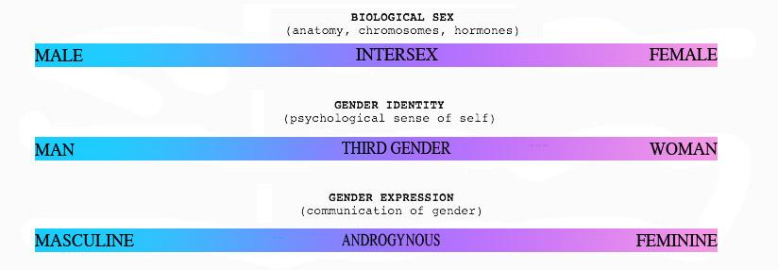
Human Sexuality and Gender Identity Spectrum
Three spectrums of sex gender and gender expression source trueliberalnexus

Slide 4
What is gender identity and sexuality?
Gender Identity is one's subjective sense of being a man or woman.
Gender is a set of culturally specific norms concerning the expected behaviors and attitudes of men and women.
Gender dysphoria a strong desire to be of the opposite gender or insistence that they are of the other gender.
Transgendered a individual whose gender identity and gender roles are the opposite of what society expects based on anatomy.
Source textbook

Slide 5
What is Gender identity and Sexuality?
Sexual orientation: a distinct preference for sexual partners of a particular sex in the presence of clear alternatives.
Heterosexual: an individual with a sexual orientation primarily to members of the opposite sex.
Homosexual: an individual with a sexual orientation primarily to members of the same sex.
Bisexual: an individual with an orientation toward both men and women.
Source textbook

Slide 6

Asexuality
Gray A & Demi-Sexual
Allies
Community
Notes:
The Asexual Visibility and Education Network. (n.d.). Retrieved June 10, 2019, from https://www.asexuality.org/

Slide 7

Asexual Spectrum
ACE
An Asexual individual is someone who does not experience sexual attraction.
Ace individuals have relationships can have attraction, and can experience arousal like everyone else.
Asexuals do experience arousal like everyone else.
ACE spectrum broken down
ACE
Grey- A
Demi-Sexual
Sexual
Aromantic
Biromantic
Heteroromantic
Homoromantic
Panromantic

Slide 8
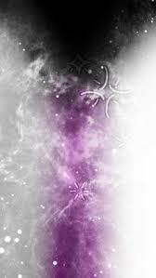
Grey- A and Demi-Sexual
Grey Ace or Grey A is an individual who experiences some sexual attraction under certain circumstances.
Most grey ace individuals are non sexual hut are Grey A because they are curious and look to fulfill that curiosity.
For individuals who are Demi sexual it requires a deep connections and bond before anything will become intimate.

Slide 9

Sub groups
Aromantic- individuals who do not experience sexual attractions but seek romantic or platonic relationships.
Biromantic- Is an individual who likes more than one gender.
Heteroromantic- individual who is romantic with the opposite sex.
Homoromantic- individual who is involved with the same sex
Panromantic- Individuals who do not discriminate against any gender

Slide 10

Bisexuality
Bisexuality is defined as an attraction (either emotional or sexual) to females and males.
Some bisexual people may choose to label themselves as pansexual
The bisexual flag has a pink stripe, a purple stripe, and a blue stripe.
Some people who are bisexual have a preference for one gender identity. Others have no preference.
Even in instances where a person has a strong preference for one gender over the other, they can still choose to identify themselves as bisexual.

Slide 11

Common Myths Debunked
Myth: Bisexuality doesn’t exist; you have to pick a side
Fact: Bisexuality is natural and normal in many species
Myth: Bisexual people are more likely to cheat
Fact: If a bisexual person is in a monogamous relationship they are no more likely to cheat than a heterosexual or homosexual person
Myth: Bisexual people are just homosexuals who are afraid to come out
Fact: Considering we get smack from both gays and straights I’d say not

Slide 12
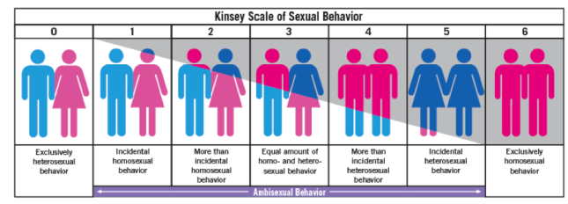
Heterosexuality
The Kinsey Scale
Source queer glossary

Slide 13
Heterosexuality
Heterosexuality is also called being straight. This relates to a spectrum, When we look at a orientation on a spectrum I connect this to the kinsey scale. Exclusively heterosexual is a zero while exclusively homosexual. The Kinsey scale represents a good example of how sexuality is a spectrum.

Slide 14
Notes on Heterosexuality
Heterosexuality is a very common orientation, and with this orientation is certain privileges that it has. LGBTQ individuals are a minority, and they have and still are fighting for rights equality and respect in our society. While it is important to acknowledge heterosexuality we must educate ourselves on other sexualies and gender identies to understand, and to be able to create a more welcoming and open society.

Slide 15
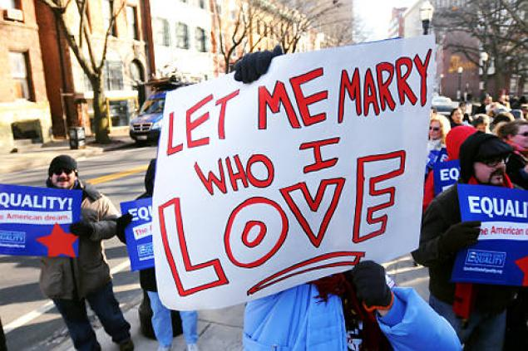
Homosexuality
Pic from psu.edu/reshmakjblog/tag/gay-rights/
Correct and Incorrect terms: Homosexuality as mentioned in the introduction is when an individual is attracted to their same sex. Males are often referred to as gay and females are often referred to as lesbian. “Over time there have been many derogatory terms used to describe homosexuals (‘faggot, ‘fairy’, ‘dyke’)” (Regan & King 234). Everyone should stay away from using these words as they are very hurtful.
Negative viewpoints of homosexuality: Some believe these people are mentally ill, or are “from the devil” due to their religious beliefs. Another reason people are anti-LGBTQ has to do with that “they could never produce children except by surrogacy” (Straton). The first two reasons are false and even though third is true adoption is a wonderful option and my reasoning behind this will be supported on my next slide.
Positive viewpoint: We are all human beings who deserve to be treated equally even if our sexual orientations are not the same! Their sexuality is not yours nor is their body or their life.
Social status of homosexuals: As of right now a lot of homosexuals still hide their sexual identity as they do not want to be discriminated when trying to apply for housing, a job, healthcare, and even in their general life/family life. Others are brave and do not hide but have to deal with the judgment of the people in public. This is not how the LGBTQ community should have to live.

Slide 16
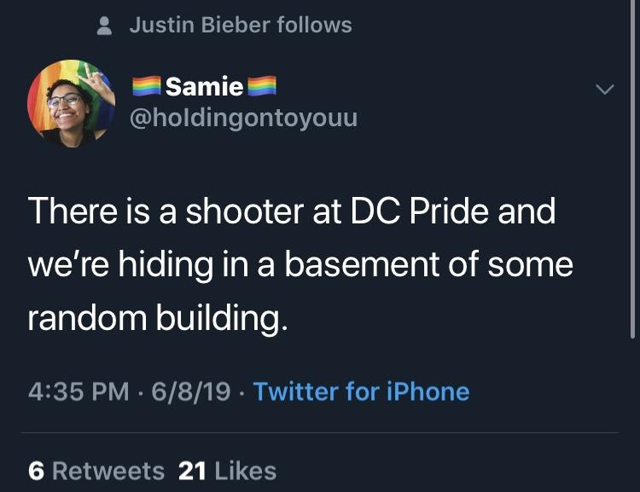
Homosexuality continued:
Assumptions/Opinions before and after research
Before research I thought that our country had changed significantly when it came to treating the LGBTQ community equally without prejudice. After talking with Sam Watkins the President of the Rainbow alliance at SVC, researching myself, and even being on social media my assumptions were not 100% correct. Sam mentioned that our country did take a big step forward when gay marriage was legalized but ever since then our country has not done anything drastic to improve the LGBTQ quality of life in America.
Living in fear: On June, 08, 19 I saw this tweet. After reading up about it the report was false however the fear behind the situation was not. The parade was canceled early as everyone ran in fear for protection. “‘Even if it turns out no shots were fired at #dcpride that doesn’t mean real trauma didn’t just occur,’ Twitter user Emily C. Heath said in a post on the platform. More LGBTQ people live in fear of something like this happening every day. To run because you think your life is in danger is traumatic’" (ABC News). It is important to include that people were injured from the panic.
Homeless: Sam mentioned that “40% of homeless teenagers are a part of the LGBTQ community.” One reason behind this has to do with not being accepted by their own parents. In the article, Young, gay, homeless and invisible: a growing population? the author interviewed many homosexual men who became homeless and why it happened. Being homosexual was not the always the only reason for being homeless as drug addiction, being poor, and have mental illnesses like depression also came into play. Being gay was considered to be “the cherry on top.”
Photo from Twitter
From the research article a man named Ted shared his coming out experience at age 17. He said “I got absolutely battered when I came out to my step-dad. Um, I had a black eye, all sorts. I mean I got a good hiding for that ... I just couldn’t stay, I couldn’t stay. I just, I had to leave cause I’d like bruised ribs, black eye and ... I couldn’t stay” (Culture, Health, and Sexuality).

Slide 17
Transgender
Transgender is a term that is used to describe someone who is uncomfortable with their birth gender.
The medical diagnosis of this is gender dysphoria
While not all people with gender dysphoria are transgender many are.

Slide 18
Gender dysphoria
Used to be a medically diagnosed mental illness no longer is
While it may not be a mental illness gender dysphoria patients have mental aspects to their condition
Hormone imbalances in the womb
Intersex complications

Slide 19
Cisgender
Cisgender simply means the same thing as “straight”
Identifies as the same gender as sex assigned at birth
A cisgender male is born male and identifies as male same for female

Slide 20
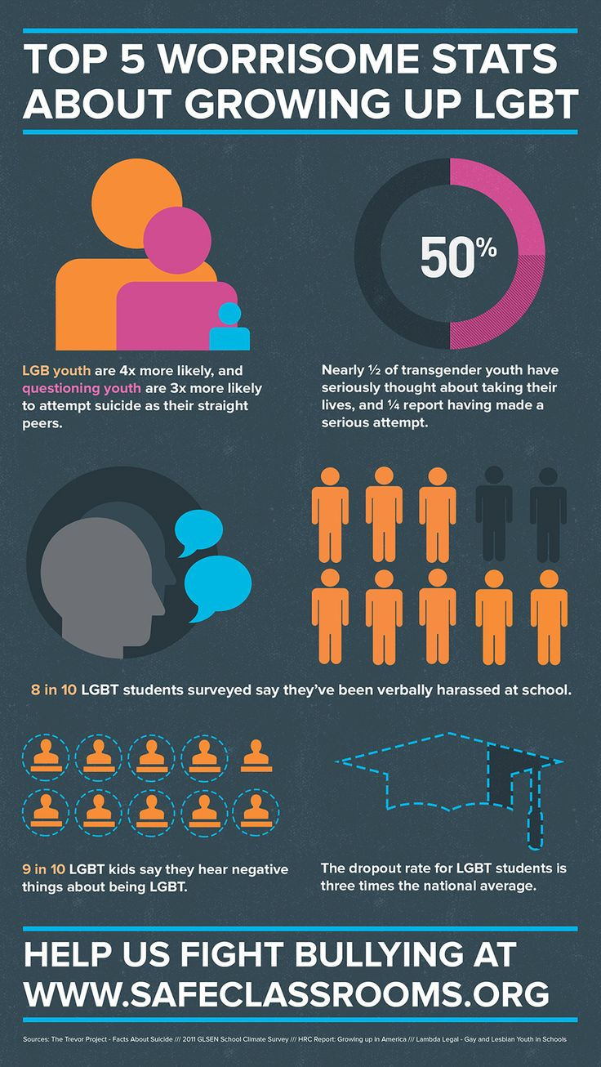
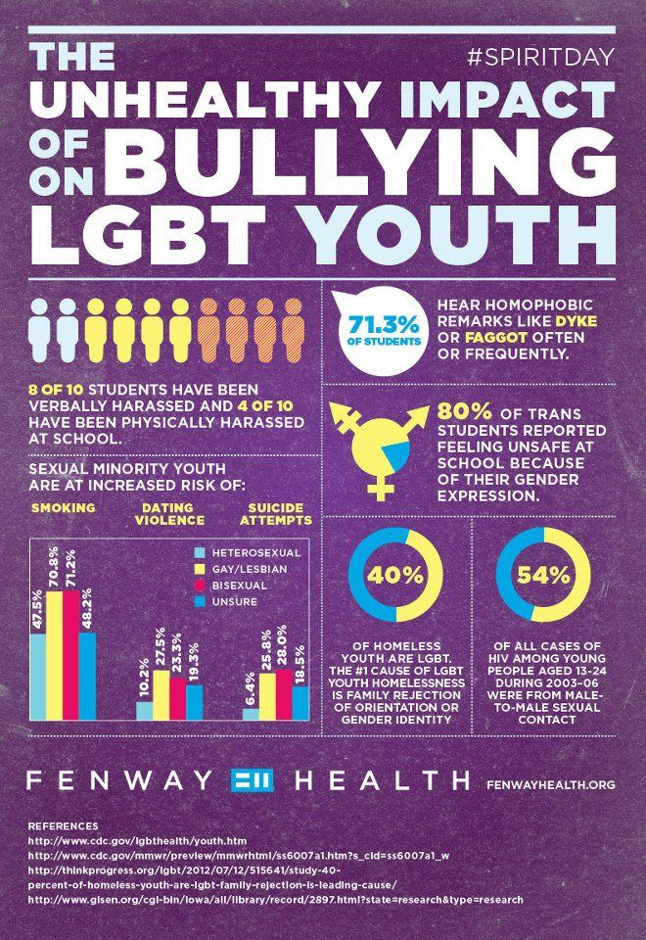
LGBTQ+ Statistics
Pic from
https://www.pinterest.com/pin/290482244686610331/?lp=true
Picture from LGBT.net

Slide 21
Works Cited
Asexuality. (2019, June 02). Retrieved from https://en.wikipedia.org/wiki/Asexuality
Dunne, G., Prendergast, S., & Telford, D. (2002). Young, gay, homeless and invisible: a growing population? Culture, Health, & Sexuality, 4(1) 103-115.
King, Bruce M. Human Sexuality Today: Books a La Carte New Mydevelopmentlab. Prentice Hall, 2011.
“What Gender Spectrum?” True Liberal Nexus, 8 Jan. 2014, trueliberalnexus.wordpress.com/2014/01/07/what-gender-spectrum/.
Nikki, Rider. “The Kinsey Scale.” Queer Glossary, 1 June 2016, queerglossary2016.wordpress.com/2016/05/30/kinsey-scale/
Maile, Amanda. “DC Pride Parade Ends in Chaos after False Report of Gunshots, Causes 'Widespread Fear'.” ABC News, ABC News Network, 9 June 2019, abcnews.go.com/US/commotion-capital-pride-parade-false-report-gunshots-officials/story?id=63582572.
Poston, D., & Baumle, A. (2010). Patterns of asexuality in the United States. Demographic Research, 23, 509-530. Retrieved from http://www.jstor.org/stable/26349603
The Asexual Visibility and Education Network. (n.d.). Retrieved June 10, 2019, from https://www.asexuality.org/
Straton, C., Jack. (2015). Gay marriage and the paradox of existence. Contemporary Buddhism,16(2), 490-506.
Watkins, S. (2019, June 4). Personal interview.
Notes:
It is supposed to be APA

Slide 22
Works cited Part 2
“What Is Gender Dysphoria.” What Is Gender Dysphoria?, www.psychiatry.org/patients-families/gender-dysphoria/what-is-gender-dysphoria.
“Gender Dysphoria.” NHS Choices, NHS, www.nhs.uk/conditions/gender-dysphoria/.
Boskey, Elizabeth. “What Does It Mean to Be Cisgender?” Verywell Health, Verywell Health, 22 Apr. 2019, www.verywellhealth.com/what-does-it-mean-to-be-cisgender-3132607.

Slide 23
If you want to learn more...
https://www.thetrevorproject.org/

Slide 24
Thank You!

